Slide 1
THE COSMIC COST
Session 3

Slide 2
What is the Gospel?
John’s gospel is the most profound explanation.
*I will bless you – “one blessing after another” 1:16
*You can experience me personally 7:37-38, 17:3
*You can become part of my Eternal Family 1:12-13

Slide 3
John 1:1-18 Summary Introduction
2-12 Father/Son Relationship
13-17 Father/Son/Holy Spirit (us) Relationship
18-21 Cost to Enable this Spiritual Oikos Relationship

Slide 4
John 1:1-18
“No one has ever seen God
but God the only Son
who is at the Father’s side
HAS MADE HIM KNOWN”
Vs 18

Slide 5
John 1-12 FATHER/SON RELATIONSHIP
* Nicodemus, John 3:2, 10:34
* John the Baptist, John 3:314:23-24
* Crowds, John 6:38, 57-58
* Temple, John 7:16, 37-38
* Pharisees, John 8:28
* Jews, John 10:30
* Leaders, John 12:44-50

Slide 6
JOHN 13-17 THE LAST SUPPER
How to have true communion
* Ch 14:16-17 The Holy Spirit in You. Note vs 20
* Ch 14:26 He TEACHES you all things
* Ch 15:5 Changing Life
* Ch 16:13 He GUIDES you into all truth
* Ch 17:3 Eternal Life
* Ch 17:20-23 World may believe

Slide 7
PRAYERS on the LAST NIGHT
* Jesus prays for Peter, Matthew 22:38
* Jesus prayer for the 12, John 17
* Jesus prays for the nations,
Matthew 26, Mark 14, Luke 22

Slide 8
THE COST
* Gethsemane Matthew, 26:38, Mark 14:34
- “Sorrowful unto death”
* Gabbatha John 19:13
- Greatest miscarriage of justice
* Golgotha John 19:17
- Most painful death

Slide 9
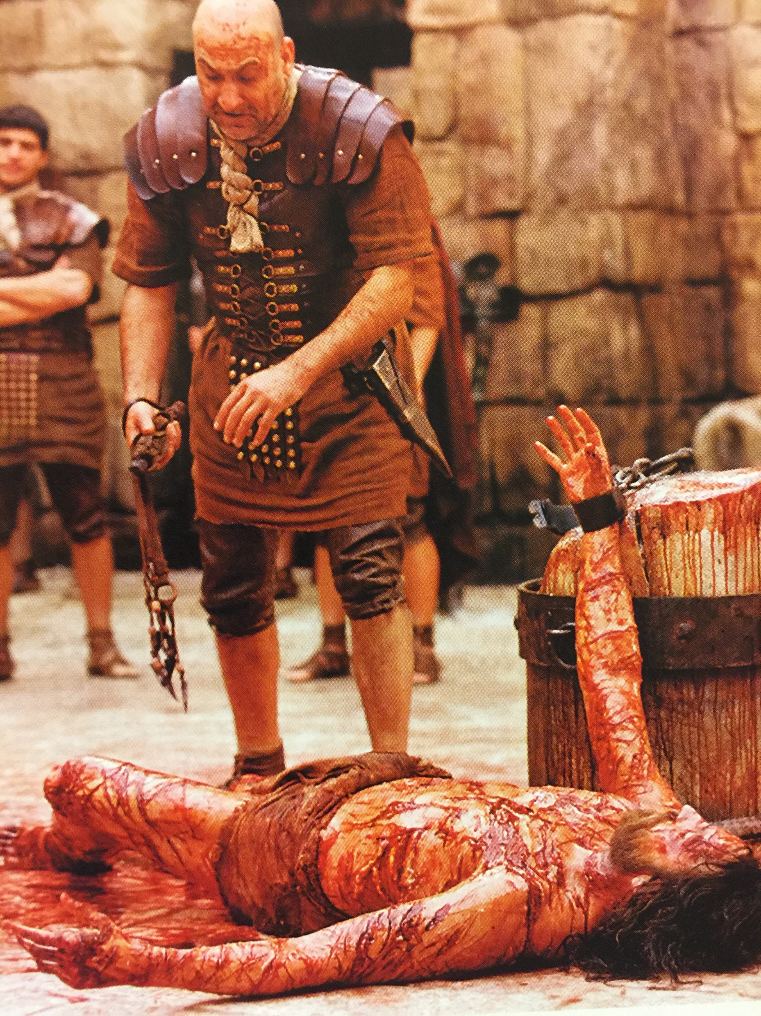

Slide 10
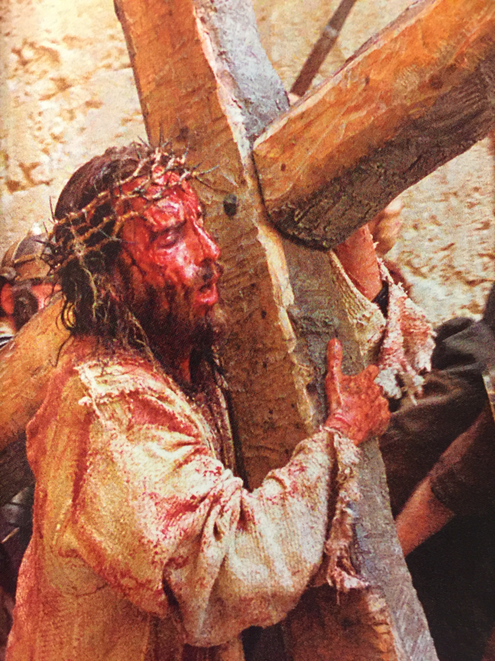

Slide 11
ISAIAH 52: 14 Physical Suffering
Emotional Suffering
53:4 Physical/Emotional
53:5-6 Spiritual Suffering
53:10-11 God’s plan
53:12 Victory

Slide 12
